Slide 1
Algorithm & Data Structure II
Heap Sort
Dr Jing Wang
jing.wang@shu.ac.uk
Cantor 9339

Slide 2
Recap: Using Array to represent Heap
Heap is a complete binary trees which can be very efficiently in space using an array
Stored in breadth-first order
A node at index n of the array, has its
left child at 2n+1
right child at 2n+2
parent at (n-1)/2
98
#0
83
#1
76
#2
80
#3
70
#4
14
#5
#0 | #1 | #2 | #3 | #4 | #5 | #6
98 | 83 | 76 | 80 | 70 | 14 | --

Slide 3
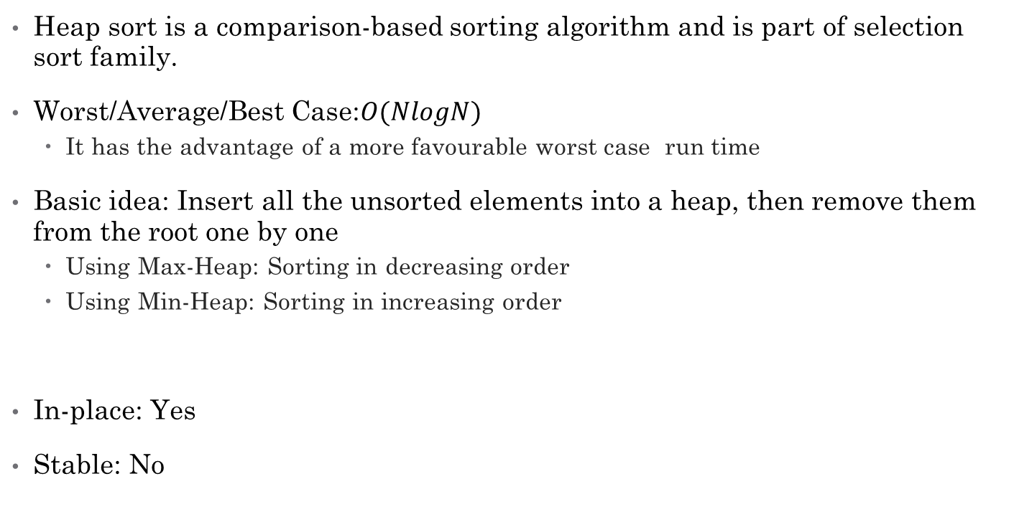
Heap Sort
Heap sort is a comparison-based sorting algorithm and is part of selection sort family.
Worst/Average/Best Case:$O(NlogN)$
It has the advantage of a more favourable worst case run time
Basic idea: Insert all the unsorted elements into a heap, then remove them from the root one by one
Using Max-Heap: Sorting in decreasing order
Using Min-Heap: Sorting in increasing order
In-place: Yes
Stable: No

Slide 4
Heapify
Starting from a complete binary tree, we can modify it to become a Max-Heap by running a function called heapify on all the non-leaf elements of the heap.
14 | 80 | 70 | 83 | 76 | 98
98 | 83 | 76 | 80 | 70 | 14
14
#0
98
#0
80
#1
70
#2
83
#1
76
#2
83
#3
76
#4
98
#5
80
#3
70
#4
14
#5

Slide 5
Heapify – Base cases
83
The parent is already
the largest
no change
80
70
80
83
The left/right child is
the larger than its
parent
swap with parent
83
70
80
70

Slide 6
Heapify – Recursion
14
#0
83
#1
98
#2
80
#3
76
#4
70
#5
To maintain the max-heap property for the entire tree, we will have to keep pushing 14 downwards until it reaches its correct position by using down heap algorithm.

Slide 7
Heapify – Recursion
98
#0
83
#1
14
#2
80
#3
76
#4
70
#5
To maintain the max-heap property for the entire tree, we will have to keep pushing 14 downwards until it reaches its correct position by using down heap algorithm.

Slide 8
Heapify – Recursion
98
#0
83
#1
70
#2
80
#3
76
#4
14
#5
To maintain the max-heap property for the entire tree, we will have to keep pushing 14 downwards until it reaches its correct position by using down heap algorithm.

Slide 9
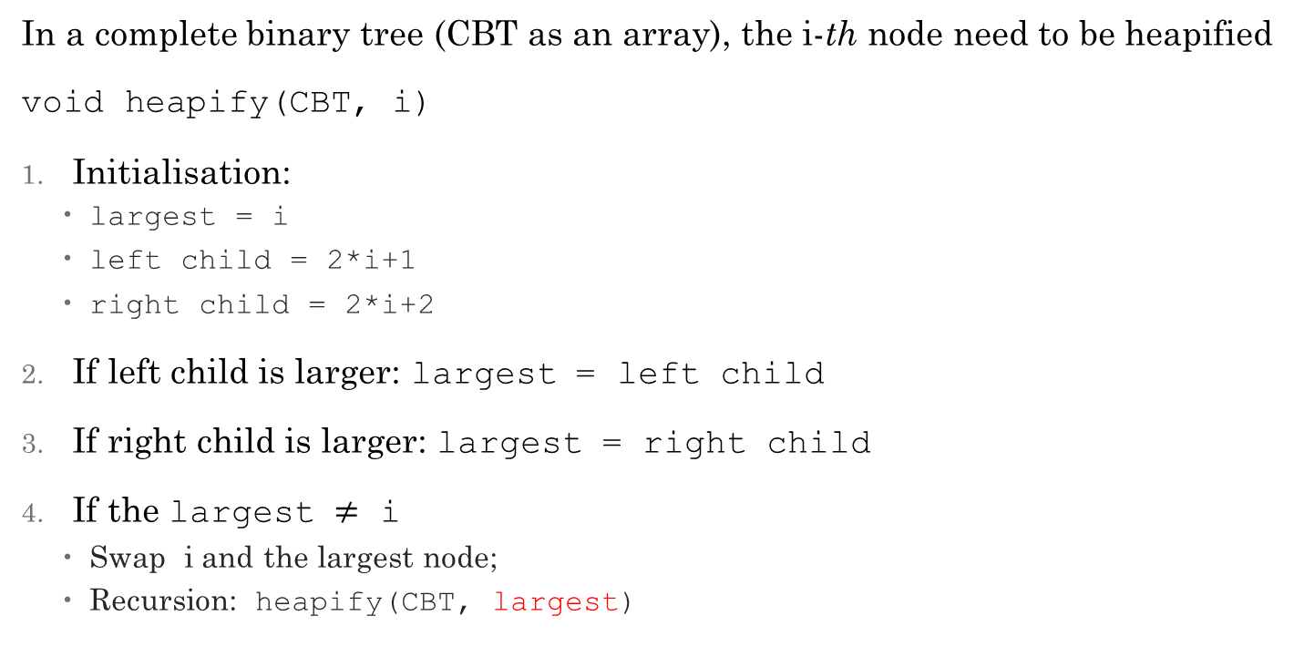
Heapify - Algorithm
In a complete binary tree (CBT as an array), the i-th node need to be heapified
void heapify(CBT, i)
Initialisation:
largest = i
left child = 2*i+1
right child = 2*i+2
If left child is larger: largest = left child
If right child is larger: largest = right child
If the largest $≠$ i
Swap i and the largest node;
Recursion: heapify(CBT, largest)

Slide 10
Build Max-Heap
Heapifying each sub-tree from the bottom up and end up with a max-heap after the function is applied on all the non-leaf elements including the root element.
n
14 | 80 | 70 | 83 | 76 | 98
last non-leaf node = n/2 -1
14
#0
80
#1
70
#2
for (int i = n/2 - 1; i>=0; i--){
heapify(CBT, i);
}
83
#3
76
#4
98
#5

Slide 11
In-place Heap Sort Algorithm
Since the Heapified tree satisfies Max-Heap property, then the largest item is stored at the root node.
Initialise an "unsorted boundary" at the end of the array
Swap the root element with the item at the end of array
Unsorted boundary = Unsorted boundary -1
“Down heap” the current root
Repeat the Step 3 - 5 until unsorted boundary become 0.

